Slide 1
Tunneling

Slide 2
Quantum Tunneling Through a Thin Potential Barrier
Total Reflection at Boundary
Frustrated Total Reflection (Tunneling)
2a = L

Slide 3

A Rectangular Potential Step
CASE II : E_{o} < V
Region 1
Region 2
Region 3
In Regions 1 and 3:
In Region 2:
for E_{o} < V :

Slide 4

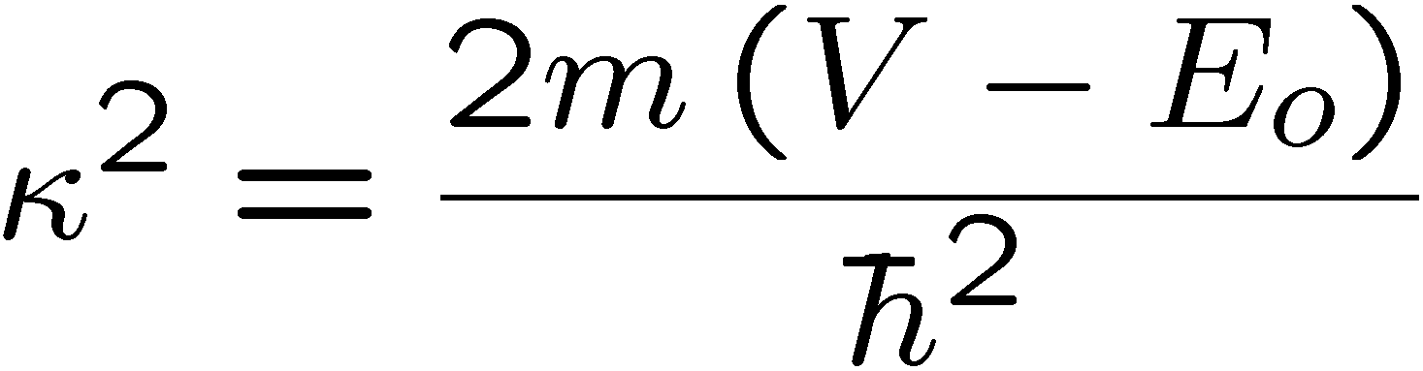

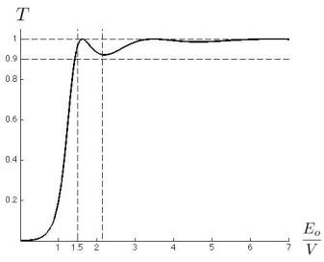
A Rectangular Potential Step
2a = L
Real part of Ψ for E_{o} < V, shows hyperbolic (exponential) decay in the barrier domain and decrease in amplitude of the transmitted wave.
x=0
x=L
for E_{o} < V :
Transmission Coefficient versus E_{o}/V
for barrier with
Tunneling Applet: http://www.colorado.edu/physics/phet/dev/quantum-tunneling/1.07.00/

Slide 5

Flash Memory
Stored Electrons
Erased
“1”
Programmed
“0”
Image is in the public domain
CONTROL GATE
Insulating Dielectric
Floating Gate
Tunnel Oxide
FLOATING GATE
SOURCE
DRAIN
CHANNEL
Channel
Substrate
Electrons tunnel preferentially when a voltage is applied

Slide 6
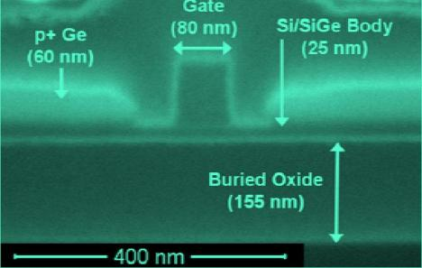

MOSFET: Transistor in a Nutshell
Conduction electron flow
Control Gate
Conducting Channel
Semiconductor
Image courtesy of J. Hoyt Group, EECS, MIT.
Photo by L. Gomez
Image courtesy of J. Hoyt Group, EECS, MIT.
Photo by L. Gomez
Tunneling causes thin insulating layers to become leaky !
Image is in the public domain

Slide 7
Reading Flash Memory
UNPROGRAMMED
PROGRAMMED
CONTROL GATE
CONTROL GATE
FLOATING GATE
FLOATING GATE
SILICON
To obtain the same channel charge, the programmed gate needs a higher control-gate voltage than the unprogrammed gate
How do we WRITE Flash Memory ?

Slide 8
Example: Barrier Tunneling
Let’s consider a tunneling problem:
An electron with a total energy of E_{o}= 6 eV approaches a potential barrier with a height of V₀ = 12 eV. If the width of the barrier is L = 0.18 nm, what is the probability that the electron will tunnel through the barrier?
V₀
E_{o}
metal
metal
0
L
air
gap
x
Question: What will T be if we double the width of the gap?
Notes:
8
Answer: With twice the thickness, the exponential factor comes in twice. Therefore, T = 4(0.011)^2 =0.05%

Slide 9
Multiple Choice Questions
Consider a particle tunneling through a barrier:
1. Which of the following will increase the
likelihood of tunneling?
a. decrease the height of the barrier
b. decrease the width of the barrier
c. decrease the mass of the particle
2. What is the energy of the particles that have successfully “escaped”?
a. < initial energy
b. = initial energy
c. > initial energy
V
E_{o}
0
L
x
Although the amplitude of the wave is smaller after the barrier, no energy is lost in the tunneling process

